Slide 1


Using Technology to Manage Complexity in Clinical Trials
Steven Beales
WCG Clinical
© Association of Clinical Research Professionals acrpnet.org

Slide 2

Disclosure
The presenter(s) for today’s session:
Steven Beales, WCG Clinical
X I/We have no relevant financial relationship in relation to this educational activity.
□ I/We have relevant financial relationship(s) with respect to this educational activity with the following organizations (list here):
© Association of Clinical Research Professionals acrpnet.org
Notes:
Hi, I’m Steven Beales. I head up Scientific and Regulatory Review at WCG. You know us from our WIRB and Copernicus IRBs, but we are also a leading provider of global safety solutions.
I’m co-chair of the Safety Reporting Quality Consortium – a consortium of 32 companies from industry and sites working on the Safety Reference Model that will be published in first half of next year.

Slide 3
Learning Objectives
Upon completion of this presentation, participants should be able to:
Discuss the impacts that multiple regulatory agencies can have on safety reporting for a global trial
Provide an overview of how technology can help to determine if an event needs to be reported
© Association of Clinical Research Professionals acrpnet.org
Notes:
It is said only top the 10% of performers attend conferences like this. My guess is that the only top 1% stay for last session of Friday afternoons.
What will you learn for your dedication is –
An understanding of how different safety reporting requirements affect global trials
1) the work we’re doing with the Safety Reference Model to reduce that burden on sites
2) And more specifically what the FDA is doing to alleviate the burden on US sites
3) And how technology can alleviate that burden

Slide 4
Agenda
Safety Reporting Overview
Safety Reporting Quality Consortium
Safety Reference Model
Burden on Sites
Conclusion
© Association of Clinical Research Professionals acrpnet.org

Slide 5
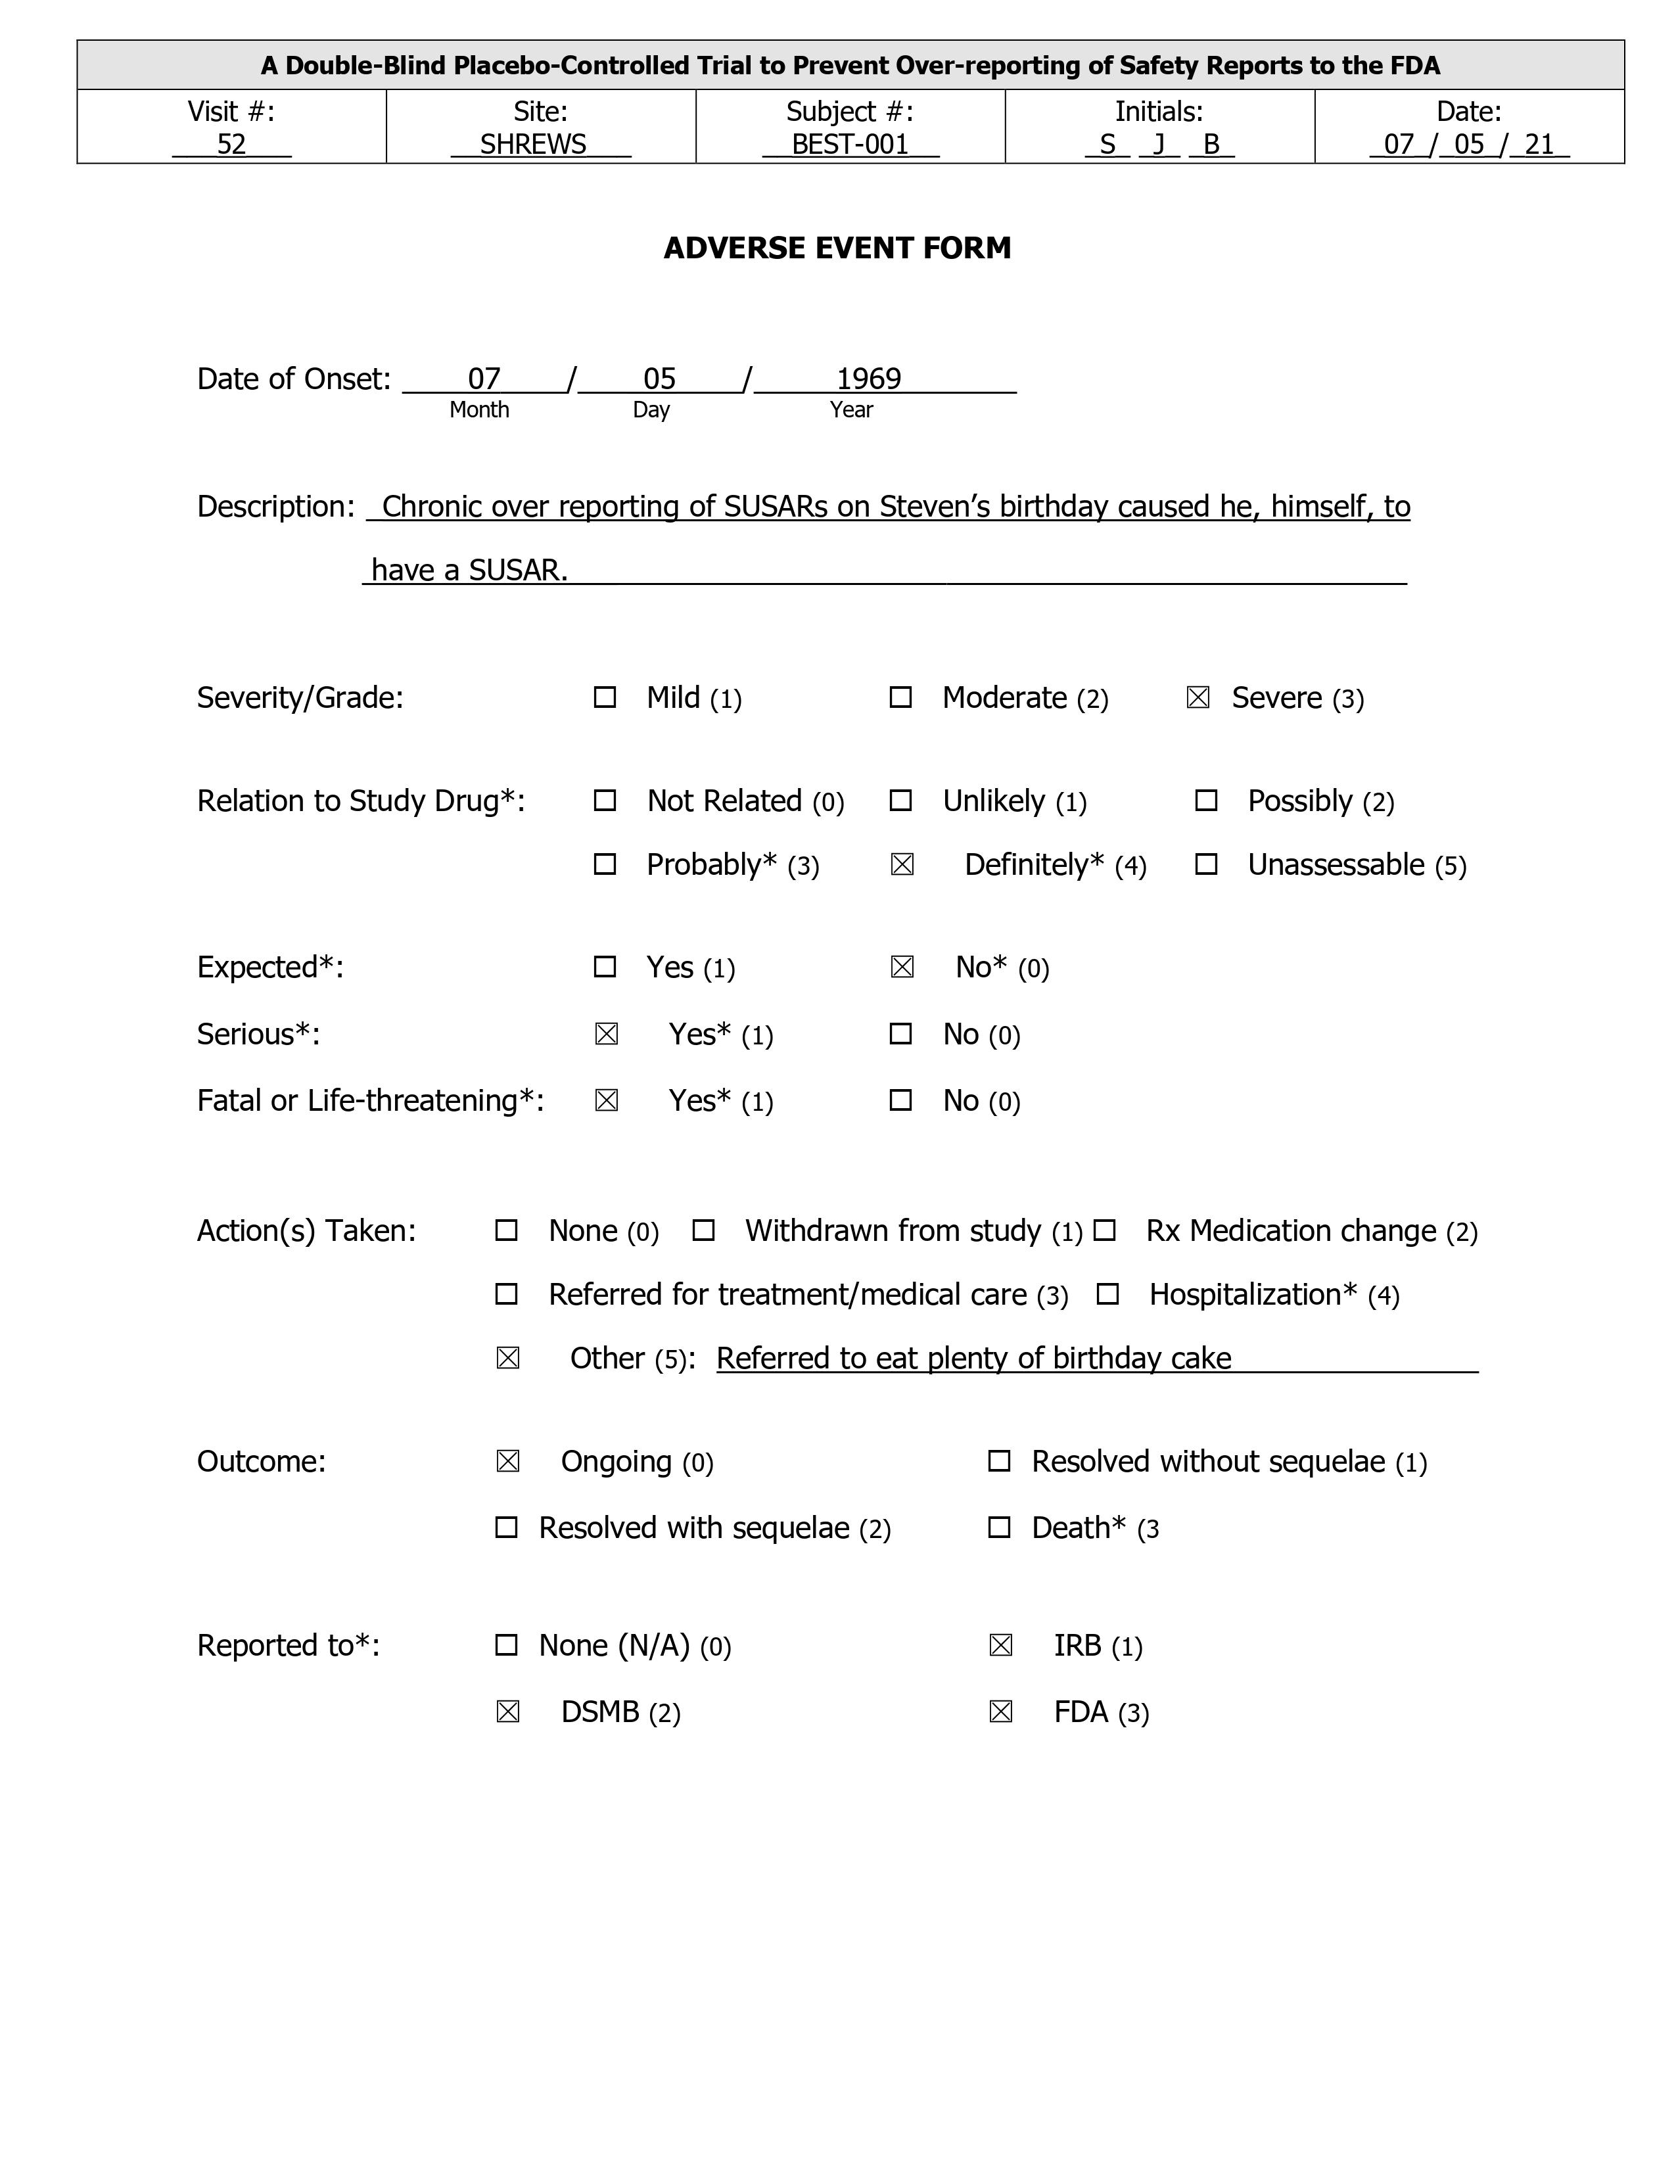
Today’s T-shirt
© Association of Clinical Research Professionals acrpnet.org
Notes:
Can you see the Adverse Event form on my T-shirt or as displayed on slide? It was kindly given to me as a birthday present by a site study manager who is passionate about highlighting the extra work she and her team receive each year from increasing numbers of unnecessary IND safety reports. I promised to wear it for today’s talk.
She mistakenly checked the causality assessment checkbox to say the event was drug-related but that’s what happens a lot when reporting SAEs in clinical trials.

Slide 6
Current Crisis in Safety Reporting
Approximately 85% of IND Safety Reports should not be sent to US Investigators per final rule +
All of us are part of that problem 85% although most of us think it’s someone else’s fault
Investigators say that IND Safety Reporting is ‘a failed system’ and an ‘exercise in checking boxes’ ^
Many investigators sign off that they’ve read safety reports but don’t read them
Largest site networks receive 18-20k safety reports per year
PIs receive 170 safety reports per quarter on average *
IND Safety Reports are over-reported but adverse events are under-reported
11% of deficiencies in FDA site inspections are for under-reporting of adverse events #
7 of top 10 academic cancer centers in US have policies refusing to review most safety reports
This is not compliant with final rule, but we all use these sites
Yet we all agree that keeping patients safe is our most important responsibility
© Association of Clinical Research Professionals acrpnet.org
Notes:
The current crisis in Safety Reporting
Approximately 85% of IND Safety Reports should not be sent to US Investigators per IND Safety Reporting final rule +
That 85% estimate is from the FDA for oncology trials. OHRP estimated it was 84% in a 10-year review of safety reports,
What does it mean to say all of us are part of that 85%? Even companies that have reduced their submissions to FDA by 90%, have many global trials sending 100% of Safety Reports out to sites who are receiving 10x as many safety reports than the FDA.
Many in industry take GCP to mean that every investigator must see the same safety info, but this is not as intended. Each country has local laws about what safety reports investigators need to see. If the FDA does not see the safety report, there is no requirement for the investigator to see it at all or it can be provided in a line listing. It should not be an expedited report.
Investigators say that IND Safety Reporting is ‘a failed system’ and an ‘exercise in checking boxes’ ^ . This statement comes from an anonymized CTTI survey in which most investigators admitted to not reading the reports, and never changing clinical practice except for Dear Investigator Letters.
Large site networks like US oncology are receiving around 20k reports annually. At WCG we have access to nearly 200m safety notifications – we find that average PI gets 170 safety reports per quarter. The median PI gets 85 reports per quarter. The numbers are skewed by PIs at largest sites.
Too many SUSAR reports are sent out from sponsors to sites but less than ½ the AEs are reported because patients and sites are often not trained on recognizing AEs in a protocol. Under-reporting of AEs is the 3rd most common major audit finding during FDA Clinical Investigator Inspection findings since 1977.
We’ve had discussions with research directors at all top 10 cancer centers in US this year. 7 out of top 10 have policies that are understandable given the quality and volume of IND safety reports that they’ve received but are not compliant to the final rule.
And this has all been exacerbated by COVID. WCG has reviewed 811 COVID-related protocols since pandemic started and AE volumes have increased 2-3x at largest pharmas.

Slide 7

Safety Reporting Quality Consortium
© Association of Clinical Research Professionals acrpnet.org

Slide 8







Safety Reporting Harmonization Working Group
Safety Reporting Quality Consortium
Top 1 US Pharma
Top 1 EU Pharma
Top 2 Japan Pharma
Top 1 US IRB
Top 2 US CRO
Top 1 US Biotech
32 Company Consortium
Notes:
I co-chair the Safety Reporting Quality Consortium – a 32 company consortium with experts from the largest US, European and Japanese biopharmas, and the largest US CROs and IRBs. The FDA is an active listener in this consortium. On Monday, we met with Jacqueline Corrigan-Curay the deputy director of CDER to provide her with quarterly updates. FDA has issued 2 minor safety reporting guidance updates this year but acknowledge that the final rule has not succeeded in its goal to reduce the number of expedited safety reports – instead, they are increasing every year.
Our consortium mission is 3Ds -
Democratize safety reporting by sharing information from bottom up.
Diversify safety reporting by opening access to more countries and diverse safety profiles
Deliver quality by eliminating complexity and reducing costs
Like the TMF Reference model, we are driving global harmonization in reporting rules from the bottom up for Regulatory Authorities, Investigators and Ethics Committees by creating a reference model of global safety reporting rules
Even though the FDA and EMA meet regularly, their philosophies are moving further apart. The FDA put the primary responsibility for safety on individual sponsors. EMA is centralizing the responsibility.

Slide 9
Safety Reference Model
© Association of Clinical Research Professionals acrpnet.org

Slide 10
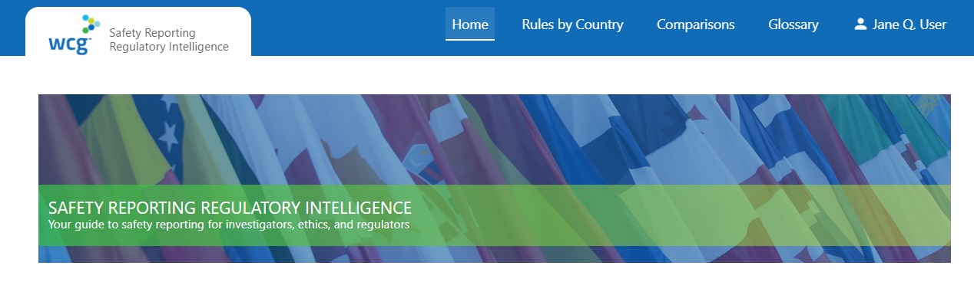
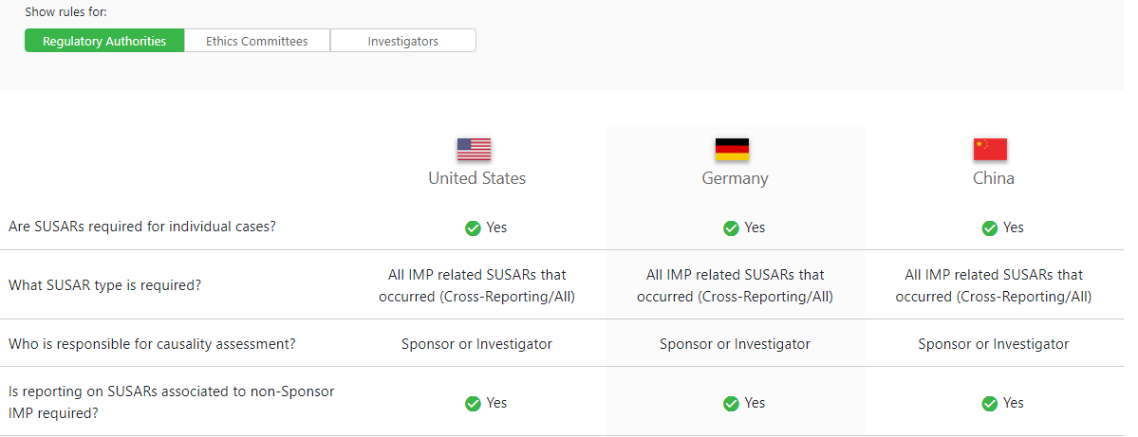
Safety Reporting Regulatory Intelligence
Safety Reference Model
Safety Reporting
Regulatory Intelligence
Notes:
Safety Reference Model
There are no existing global standards for distributing safety reports globally to investigators, ethics committees, and regulatory authorities.
Each country still uniquely regulates when and how interested parties receive safety reports with over 40 different approaches.
The safety reporting reference model consists of
Safety Document Characteristics e.g. SUSARs, Reference Safety Information
Country Characteristics e.g. Unblinding requirements, Ethics Committee, Regulatory Authority and Investigator reporting requirements
Oversight and Procedures e.g. Translation of regulations into checklists and operational steps
Currently, Biopharmas interpret local country rules themselves to decide what safety information should be distributed in each country. The goal is to eliminate this divergence in processes. Surprisingly, the major CROs are core drivers of this initiative so that they do not have to do something different for each sponsor..

Slide 11


Safety Reporting Reference Model – How is it Maintained?
Safety Reporting Reference Model – How is it Maintained?
Artificial Intelligence
Monitor Regulatory changes
Regulations, guidance and directives
Natural Language Processing
Text Summarization
Text Classification
SafetyPortal metrics and analytics
200 million records
Human Expertise
Harmonization Working Group
Changes in Interpretation of Rules
Safety Reporting Reference Model
Notes:
To maintain our model, we use Natural Language Processing to summarize and classify over 100 feeds of regulatory information.
The ability to extract the most important 6 lines as a summary from guidance has been invaluable in cutting the time to support this resource intensive activity by over 80%.
Building on work of the Aeolus project to match different safety and clinical terminology concepts and product names across countries is also essential to this effort.

Slide 12
Burden on Sites
© Association of Clinical Research Professionals acrpnet.org

Slide 13



Pressures on Clinical Trial Sites
Pressures on Clinical Trial Sites
Too Many Reports
Duplicate Reports
Overly Time-consuming
Too Many Websites
Useful Information Hidden
Notes:
How does the lack of precision distribution affect Sites?
Sites are overwhelmed with over-reported and cross-reported safety reports due to “brute-force” distribution.

Slide 14
Why do Sites get Too Many Reports?
Why do Sites get Too Many Reports?
More THAN 20 PER MONTH
AVERAGE PER QUARTER
REFUSED TO PROCESS
80%
170
20%
Number of Safety Reports
Number of Sites
Notes:
80% of sites receive more than 20 SUSARs per month.
20% have refused to process a SUSAR because it was an over-distribution – a Safety Report that did not qualify as an unanticipated problem and did not need to be submitted to the IRB.
The most common complaint from sites on our Safety Reporting site survey is - “Why can’t sponsors get their act together and stop sending us SUSARs where there is no causal relationship to the drug?”

Slide 15
What is Burden on Site Resources?
What is Burden on Site Resources?
1
1
61% SITES > 80 hours/month staff time
Including triage, review, forwarding, archiving and monitoring
2
2
$26 - ACTUAL SITE COSTS PER REPORT
Range from $17-$39, not including monitoring and annual archiving costs
3
3
$45 – AVERAGE SITE BUDGET PER REPORT
51% Gross Margin per Safety Report
Notes:
61% sites spend more than 80 hours of staff time on processing IND Safety Reports.
The average cost per safety report in labor was $26 not including any additional costs.
The average budgeted cost was $45 – so 1 consequence is that sites can generate revenue by reading unnecessary safety reports at cost of not spending time with patients.

Slide 16
Is it acceptable for PI to review only certain safety reports?
What is Burden on Site Resources?
No, it is not acceptable for an investigator to review only certain IND safety reports.*
FDA considers review of all IND safety reports critical to fulfilling investigators’ responsibility to protect the safety of trial participants in a clinical investigation.*
FDA considers a serious and unexpected adverse event that meets the criteria for Sponsor reporting to FDA and all investigators… to be an “unanticipated [problem] involving risk to human subjects or others” that therefore must be reported to the IRB by the investigator.*
Discuss:
How does a Sponsor fulfill its regulatory requirement to ensure oversight of IND safety reporting at sites that have policies such as below?
“No action will be taken with external safety reports that do not have a clear indication of an unanticipated problem classification. Such reports will not be acknowledged, signed, printed, or retained for the study file.“
* Conduct of Clinical Trials During COVID-19 QA Updated 08.30.21 – Q25
© WCG 2021
Notes:
Is it acceptable for PI to review only safety reports that Sponsor indicates will result in change to IB, informed consent, or protocol?
No, it is not acceptable for an investigator to review only certain IND safety reports.*
FDA considers review of all IND safety reports critical to fulfilling investigators’ responsibility to protect the safety of trial participants in a clinical investigation.*
Now where did the FDA clearly and unambiguously answer this question - well in Q25 of the Conduct of Clinical Trials During COVID-19 QA Last Updated 08.30.21. Not the most obvious place to look but also not open to interpretation.
The other clarification here is that any adverse event that is serious in outcome, unexpected against the RSI and related to the drug is an unanticipated problem regardless of whether it causes a change in IB, informed consent or protocol. This directly contradicts the 2007 OHRP guidance.
Below is the Harvard/Dana Farber policy –
No action will be taken with external safety reports that do not have a clear indication of an unanticipated problem classification. Such reports will not be acknowledged, signed, printed, or retained for the study file.“
Open question to anyone –
How does a Sponsor fulfill its regulatory requirement to ensure oversight of IND safety reporting at sites that have policies such as below?

Slide 17
The Importance of Safety Training
What is Burden on Site Resources?
Solutions to Under-reporting of SAEs
Educate patients on AEs and SAEs in the informed consent process
Train investigators in SAE causality algorithms such as WHO causality assessment aide-memoire
Solutions to Over-reporting of IND Safety Reports
Educate Sponsors, contract research organizations, and clinical research sites on the regulatory requirements
Report only risks that were previously unknown or unexpected in type, severity or frequency
Change protocol wording on what to report to IRBs
Revise standard operating procedures and RACIs
Submit reports to the IRB monthly or in batches
© WCG 2021
© WCG 2021
Notes:
Solutions to Under-reporting of SAEs
Educate patients on AEs and SAEs in the informed consent process
Train investigators in SAE causality algorithms such as WHO causality assessment aide-memoire
Solutions to Over-reporting of IND Safety Reports
Educate Sponsors, contract research organizations, and clinical research sites on the regulatory requirements
Report only risks that were previously unknown or unexpected in type, severity or frequency
Change protocol wording on what to report to IRBs
Revise standard operating procedures and RACIs
Submit reports to the IRB monthly or in batches

Slide 18
Conclusion
© Association of Clinical Research Professionals acrpnet.org

Slide 19
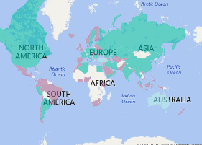
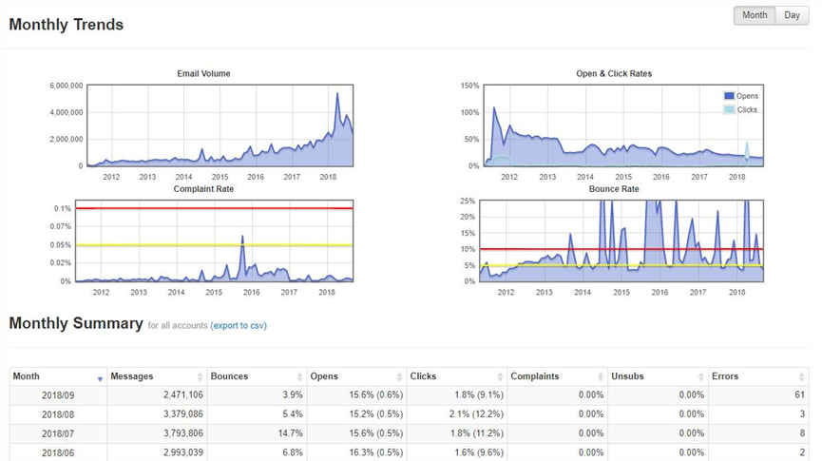
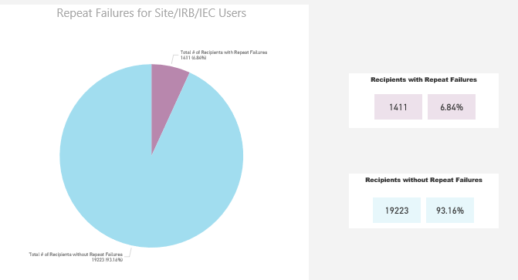
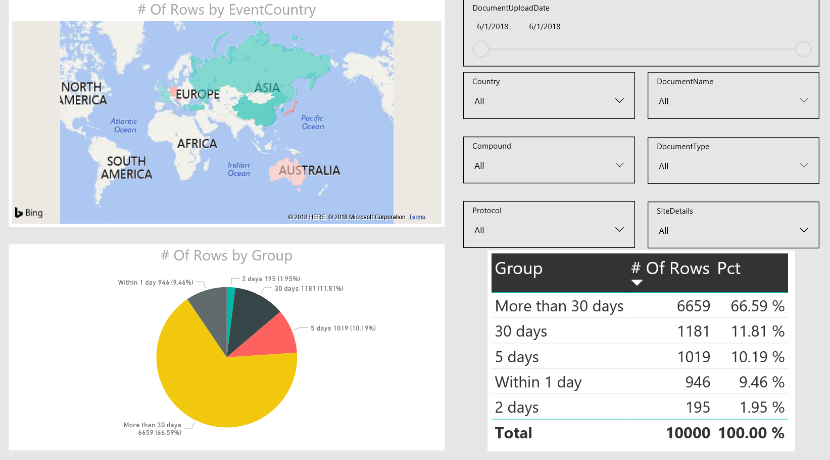
Safety Reporting Quality and Compliance
Safety Reporting Quality & Compliance
Country Rules and Amendments
Volume and target audience
Identify risk
How is the information being consumed?
Notes:
What is our suggested solution to end to end safety reporting quality oversight and compliance?
Our working group sponsors have built dashboards that focus on what we can monitor and act upon.
Monitoring regulatory environment with our working group’s input for changes in country rules and regulations
Identifying risk by ensuring all sites follow training and safety requirements
Monitoring the transmission of safety alerts and ensuring that any email bounce backs are routed directly to the responsible person so they can be fixed in accordance with regulatory timelines.

Slide 20

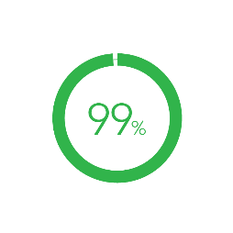
Reduction in Operational Burden
Reduction in Operational Burden
Costs
Avoided
Sites in Compliance
Reduction in Site Burden
Up to 150 - 450k
per trial
5-10 hours
per week
Notes:
For the average phase 2 clinical trial, savings have ranged between $150k and $450k per trial.
Average reduction in Safety Reports per Site has been 5 safety letters per week or 5-10 hours per week
99% of sites have trained active users in system receiving delivery.

